Slide 1
The Labyrinth
Producer : Alieke
Plannings manager : Alieke
Lead Artist : René
Lead Deveveloper : Faf
User Experience : Lara

Slide 2
Inleiding
Concept
Story
Flow chart
Planning
Uren regristratie
Assetlist
Planning
Trello
Organisatie
Naming convention
Repository
Sources
Functioneel concept
Controls
Camera
Enemies
Player abilities
Levels design
GUI
Grafisch concept
Character
Enemies
Environment
GUI
Resource budget
Technisch concept
Camera
Enemies
Player abilities
GUI

Slide 3
Concept - Story

Slide 4
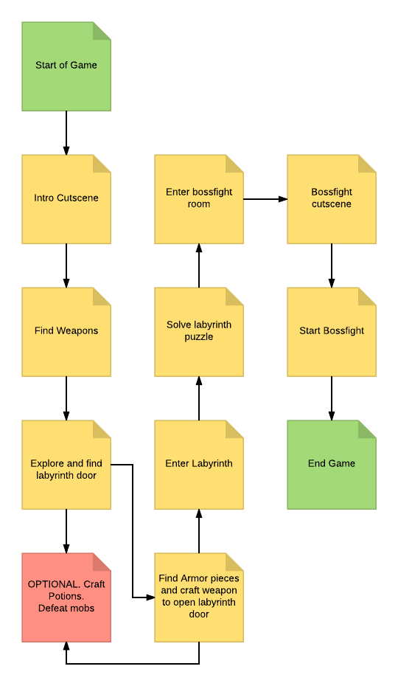
Concept – Game progression

Slide 5
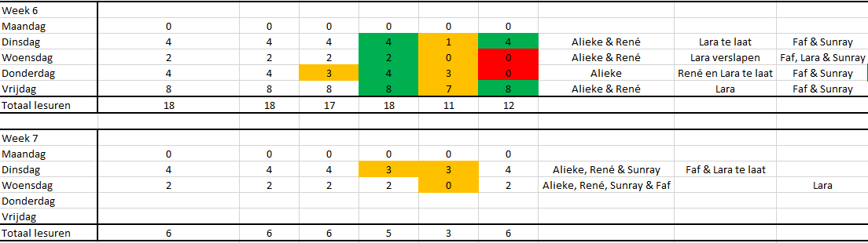
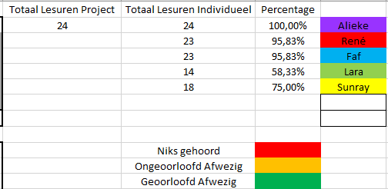
Planning – Uren regristratie

Slide 6
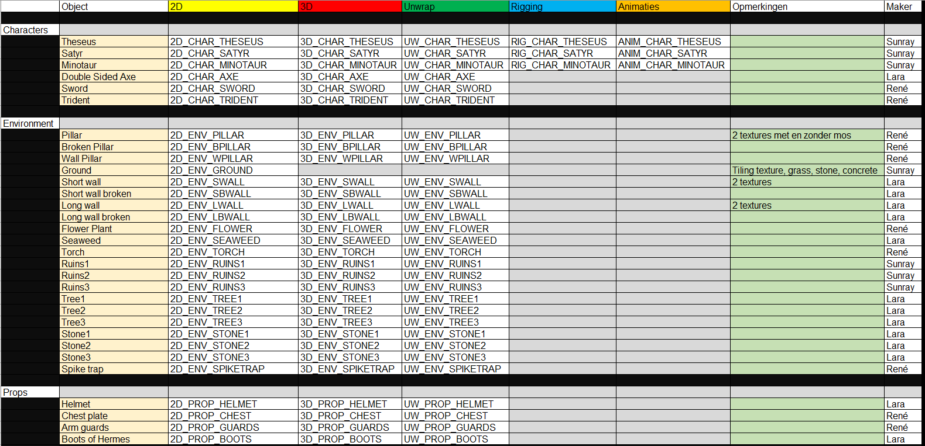
Planning - Assetlist

Slide 7
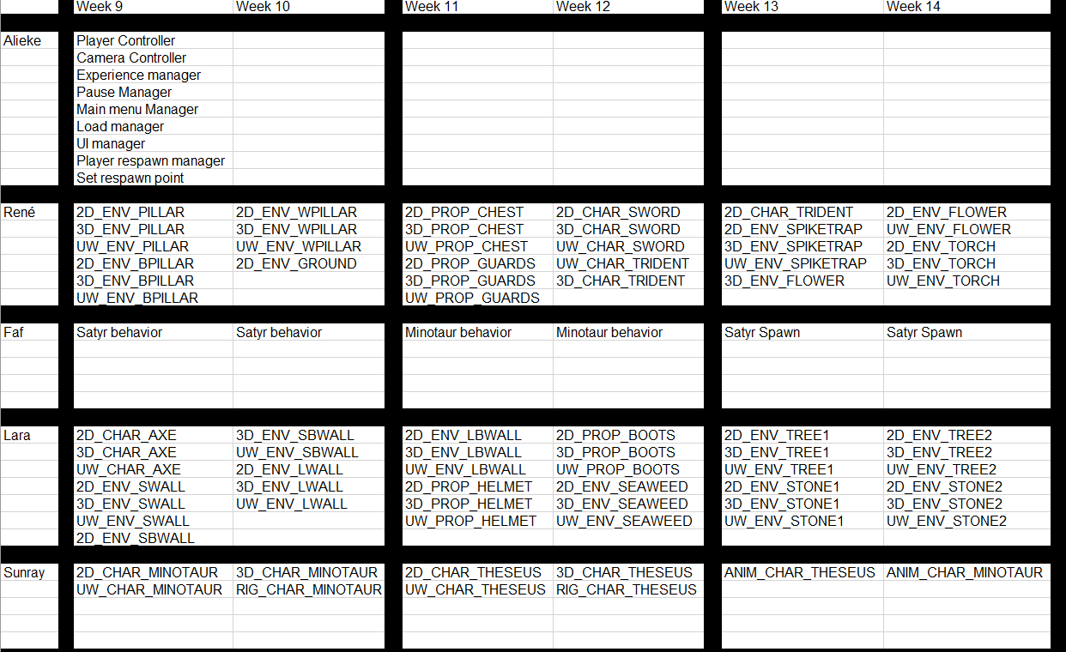
Planning - planning

Slide 8
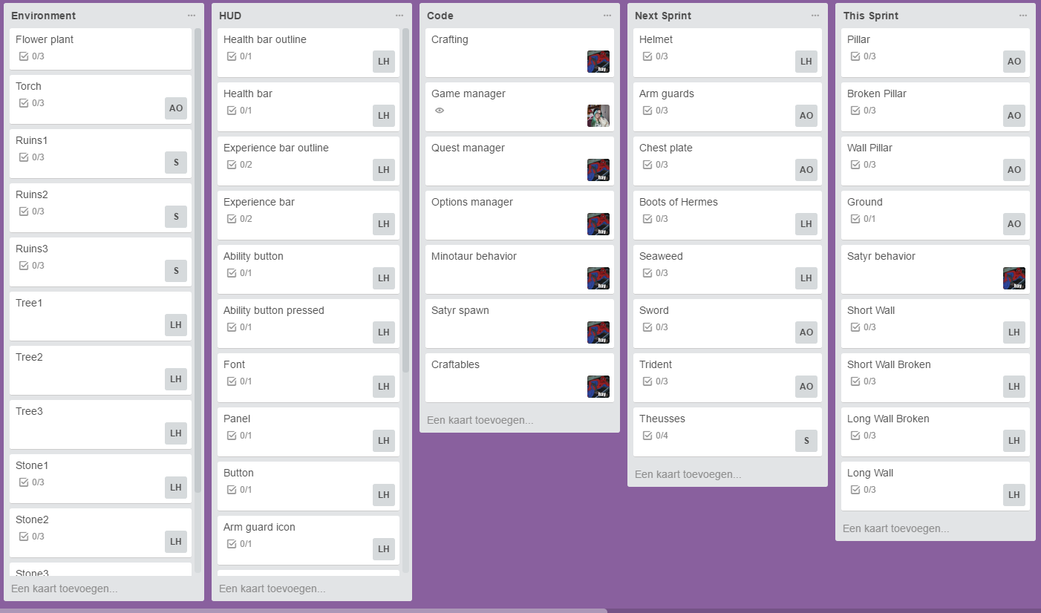
Planning – Trello

Slide 9
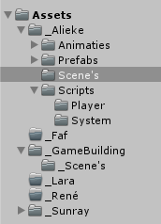
Organisatie – Naming Convention
Naamgeving
Mappen structuur

Slide 10
Organisatie - Repository
Git hub
Source tree
Git shell

Slide 11
Organisatie - Sources

Slide 12
Functioneel concept
Controls
Camera
Enemies
Player Abilities
Level Design
GUI

Slide 13
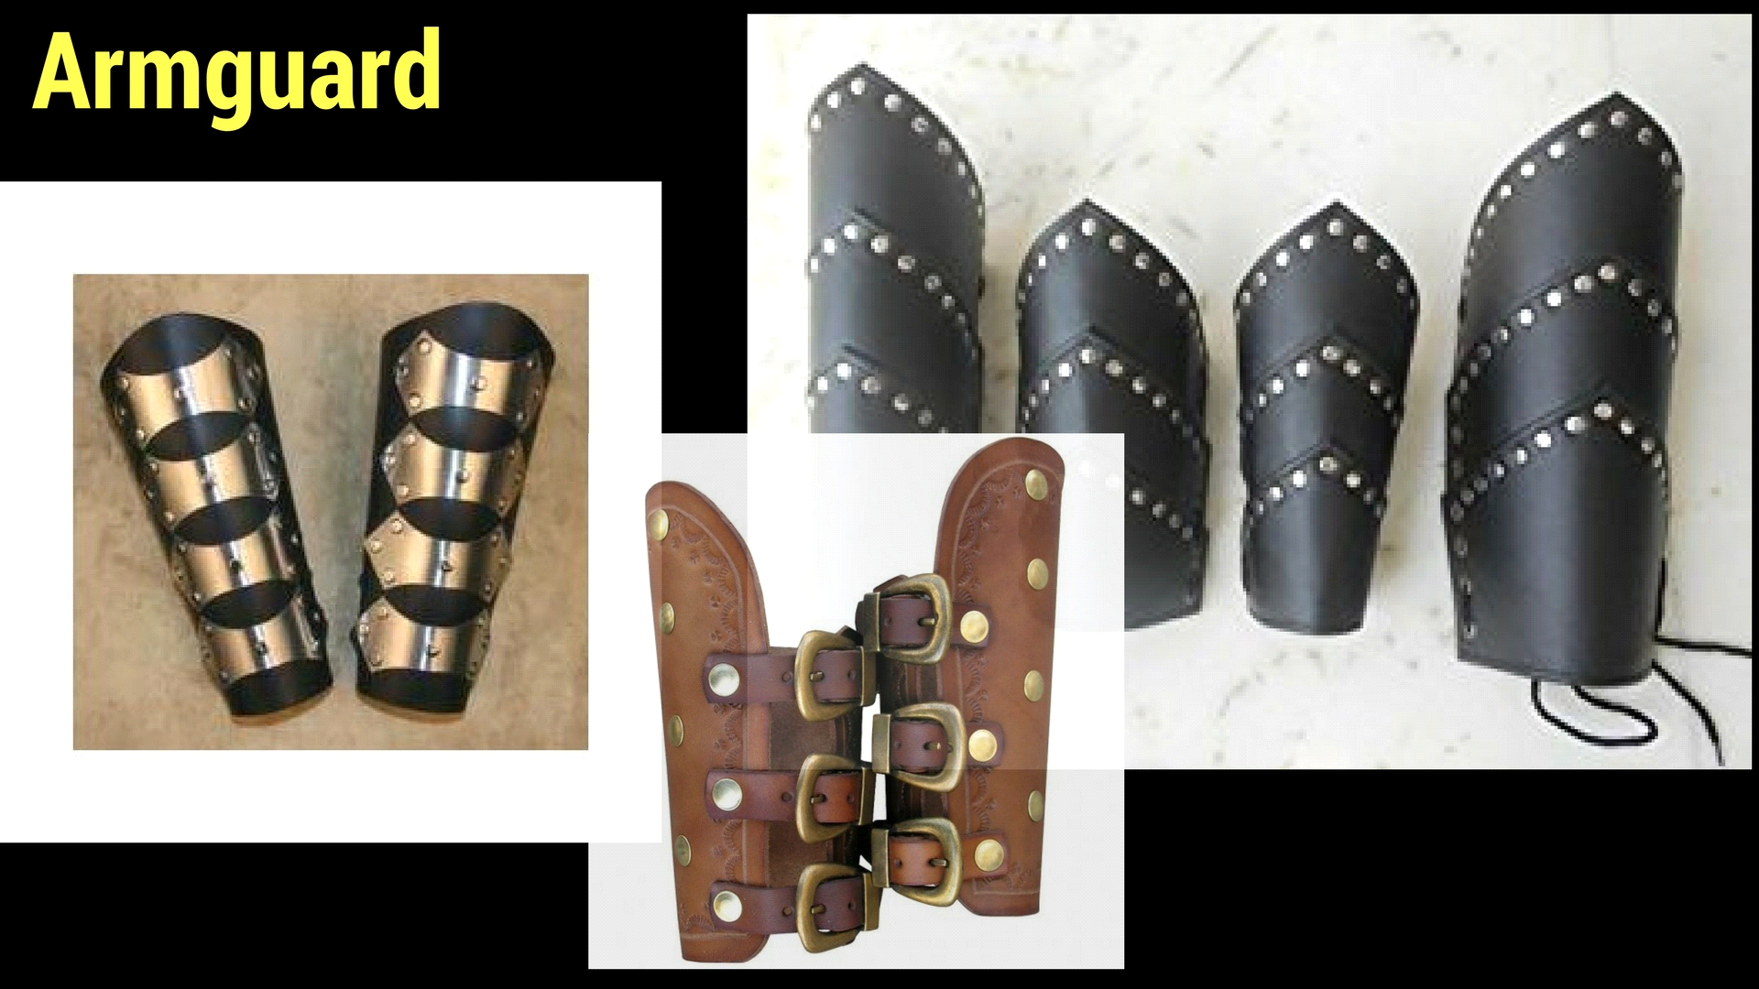
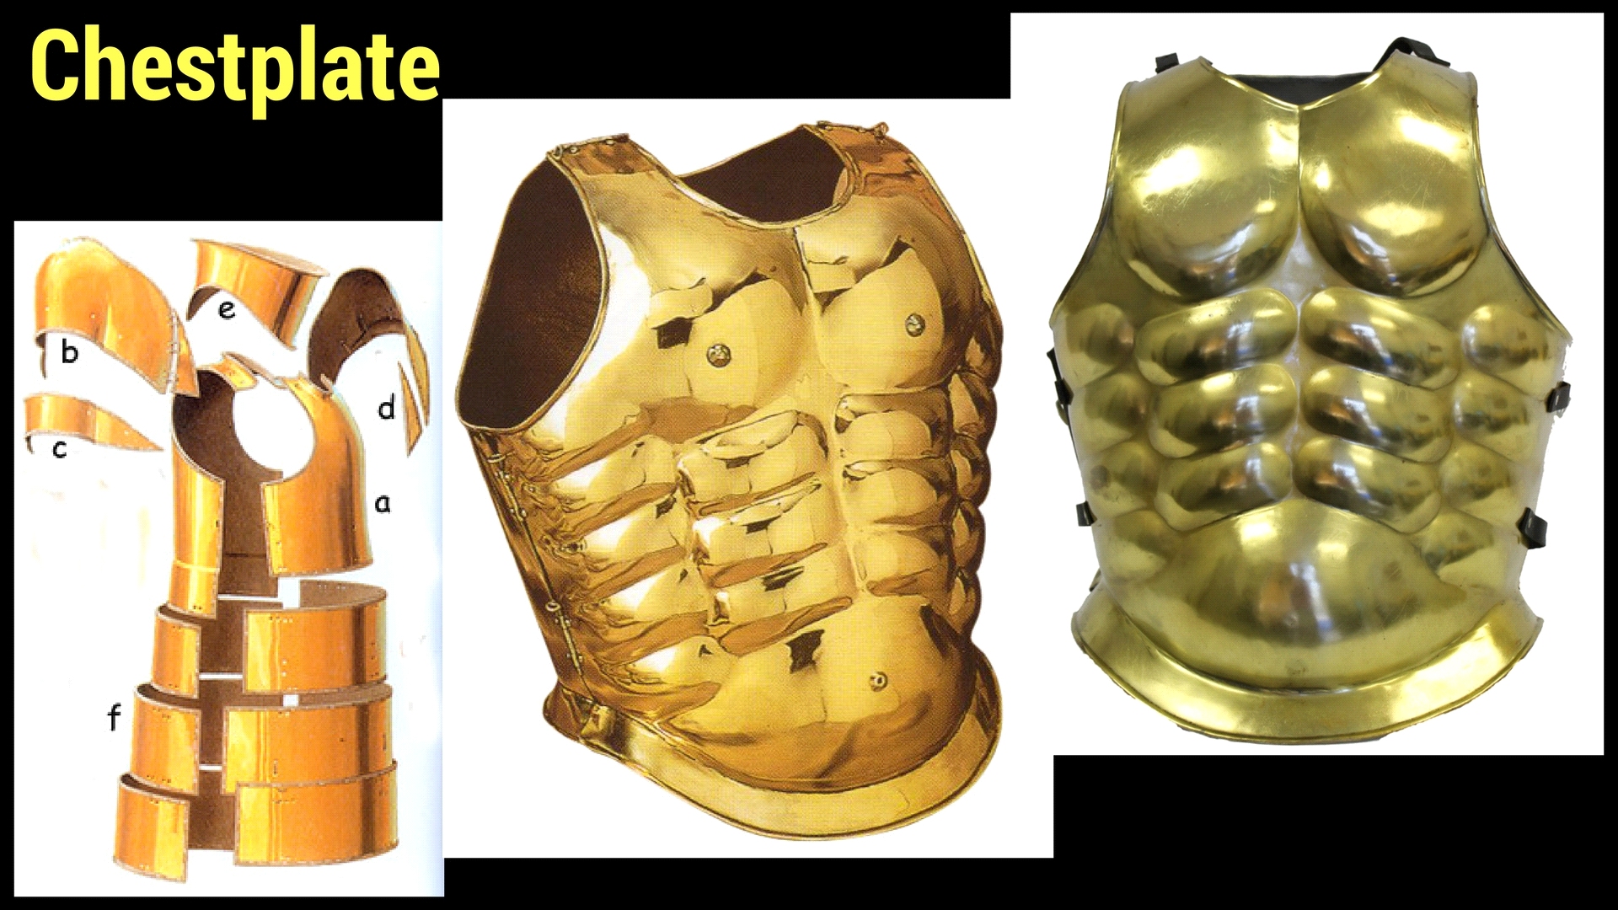
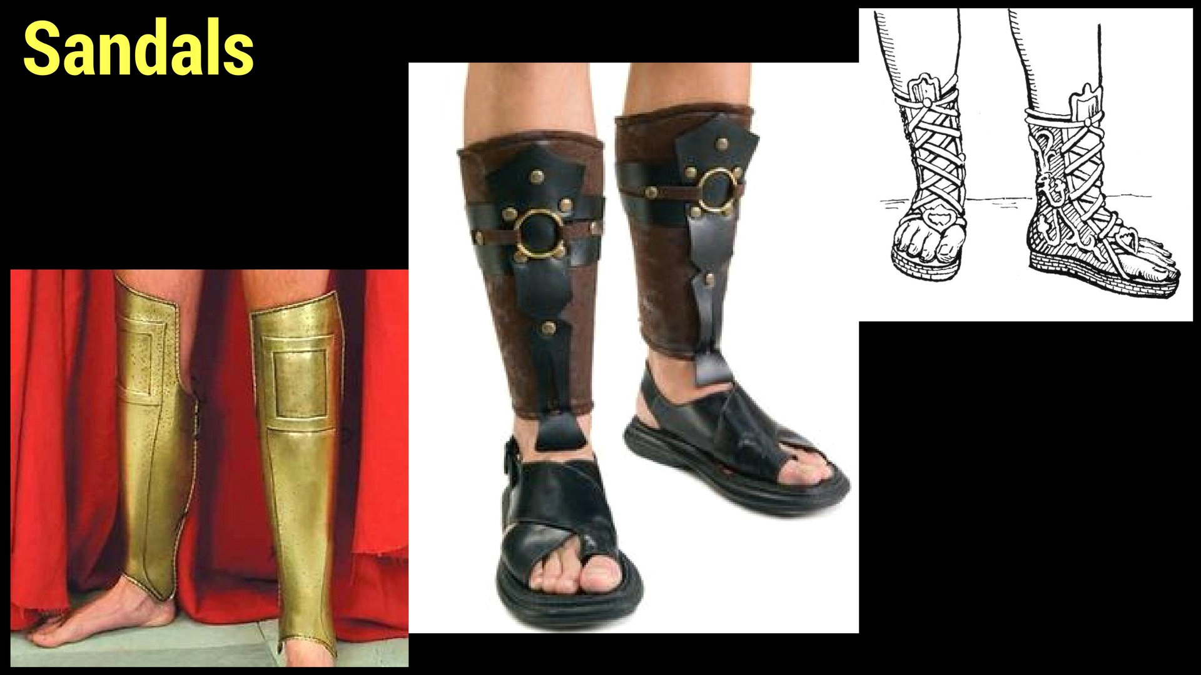
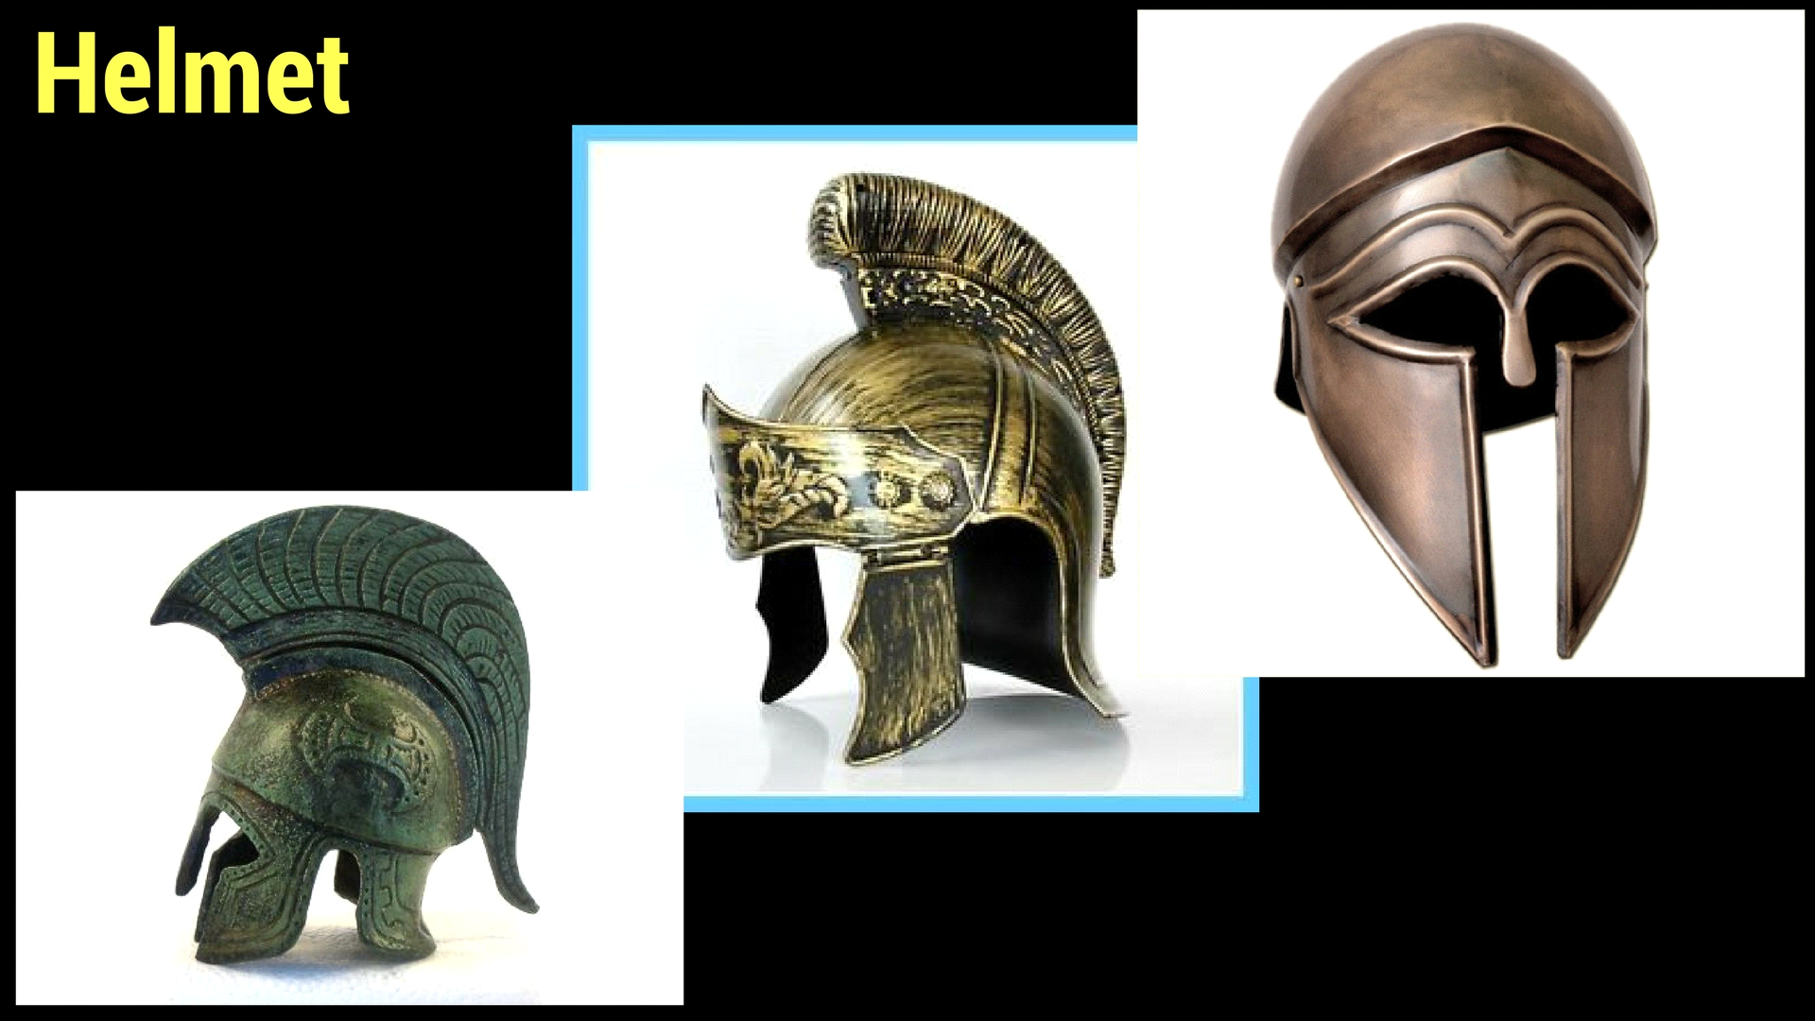
Grafisch concept - Character

Slide 14
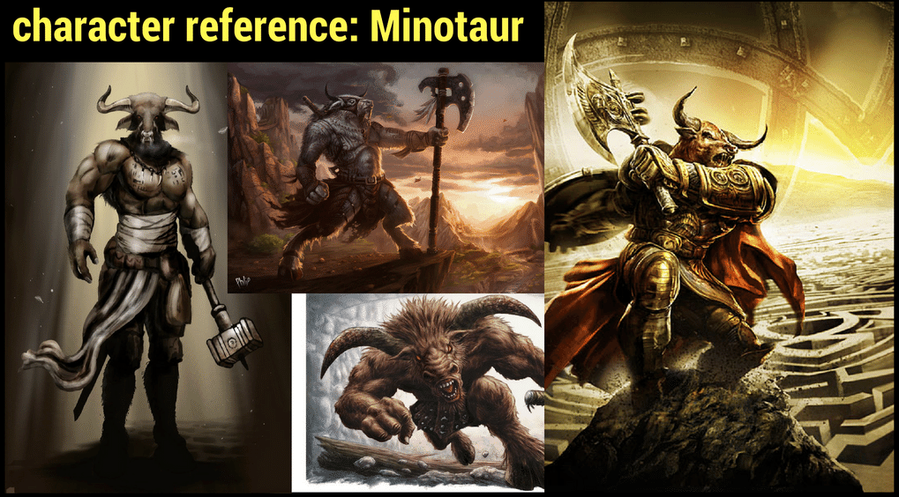
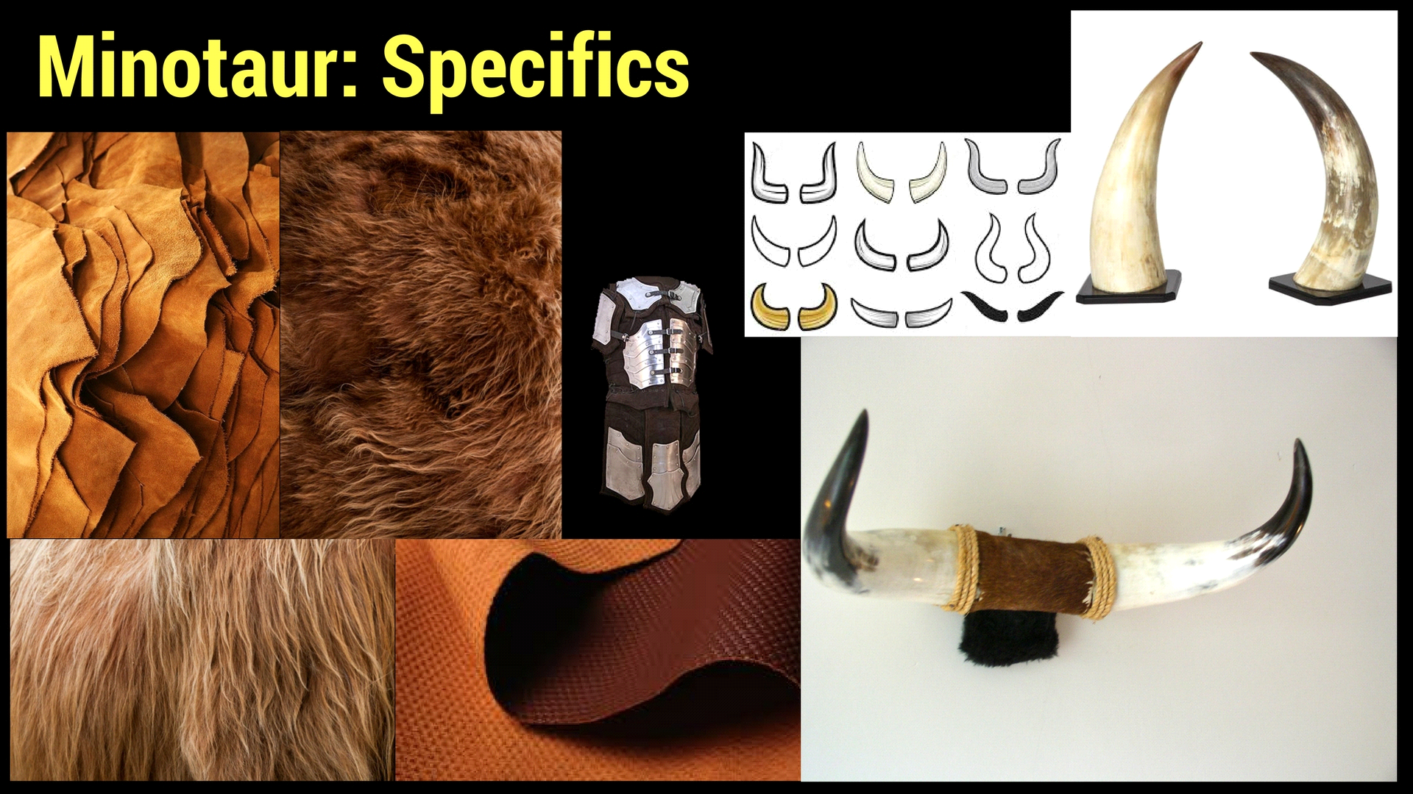
Grafisch concept - Enemies

Slide 15
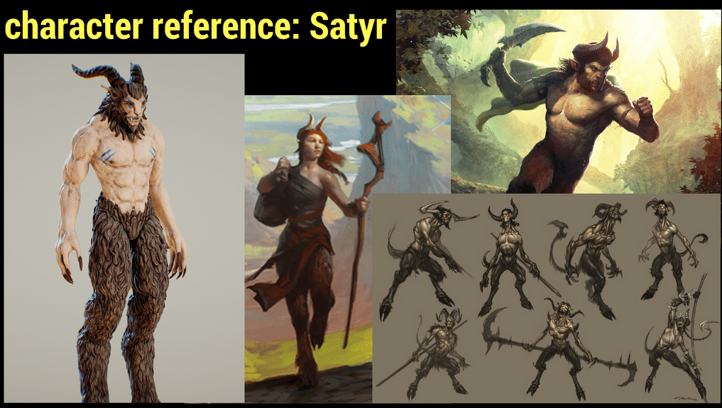
Grafisch concept - Enemies

Slide 16
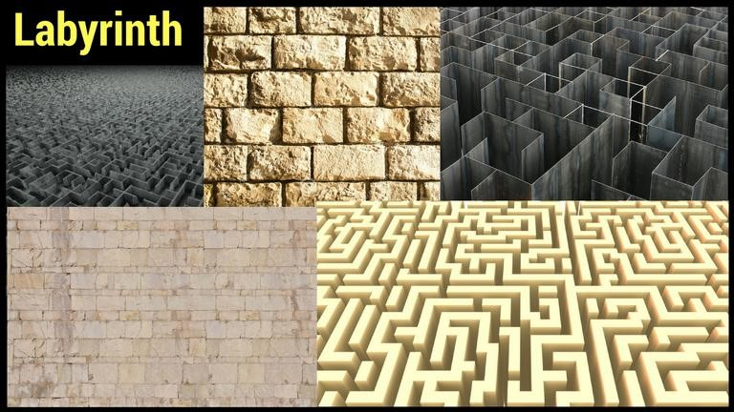
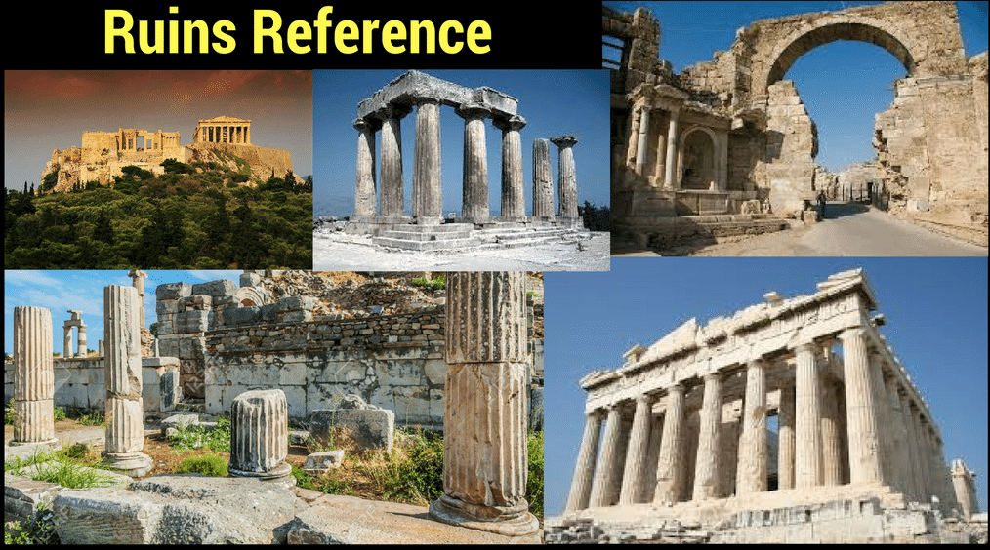
Grafisch concept - Environment

Slide 17
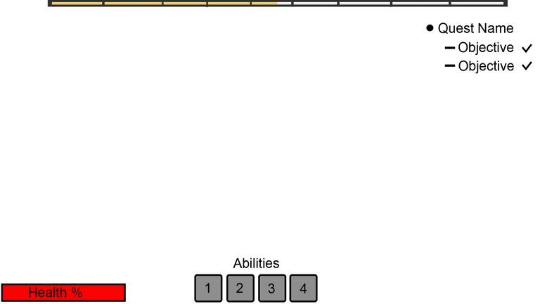
Grafisch concept - GUI

Slide 18
Technisch concept
Camera
Enemies
Player abilities
GUI

